Slide 1
AIRBNB CLASSIFICATION-
A CLASSIFICATION PROJECT BASED
ON PYTHON

Slide 2
Overview
• Airbnb, headquartered in San Francisco, operates a global online marketplace and hospitality service accessible via its websites and mobile apps. Members can use the service to arrange or offer lodging, primarily homestays, or tourism experiences
• Airbnb is an online marketplace which lets people rent out their properties or spare rooms to guests. Airbnb takes 3% commission of every booking from hosts, and between 6% and 12% from guests
• New users on Airbnb can book a place to stay in 34,000+ cities across 190+ countries. By accurately predicting where a new user will book their first travel experience, Airbnb can share more personalized content with their community, decrease the average time to first booking, and better forecast demand.

Slide 3




DATA
Our Dataset is from Kaggle
This dataset is taken from a recruiting competition, Airbnb challenges the participants to predict in which country a new user will make his or her first booking
There are 19 variable's in our dataset
For the destination country there are 12 outcomes

Slide 4
Stages of Project
01
Data Cleaning
02
Data Analysis and Visualization
03
Data Preprocessing
04
Binary Classification
05
Multi Classification

Slide 5
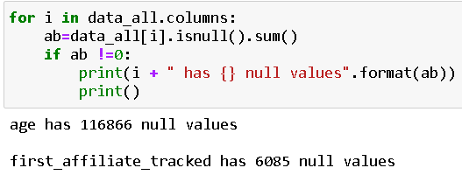
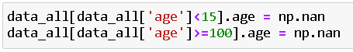
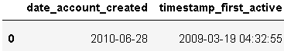
SECTION 01
DATA CLEANING
Creating DataFrame with Train and Test Data
Calculating Null values
Cleaning age > 100 or age < 15
Converting date-account-created and time-stamp-active to date format

Slide 6
SECTION 02
DATA ANALYSIS
AND
VISUALIZATIONS
The Packages used for visualization were seaborn and matplotlib-pyplot
First Visualization Gives us age distribution we can see maximum booking came from age group of 20 to 40 years
Second Visualization shows that most of user are booking from web application
Third Visualization gives year wise distribution of bookings.It can be seen the consistent increase of booking from 2010 to 2014

Slide 7
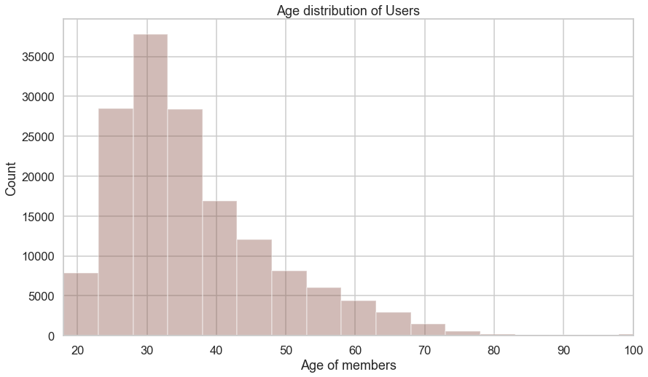
Age Distribution
SECTION 02

Slide 8
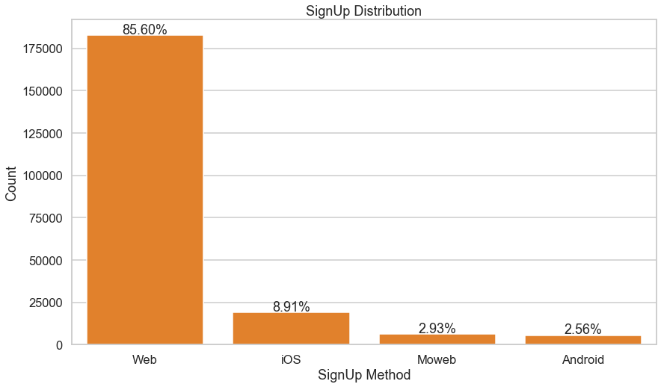
SignUp Distribution
SECTION 02

Slide 9
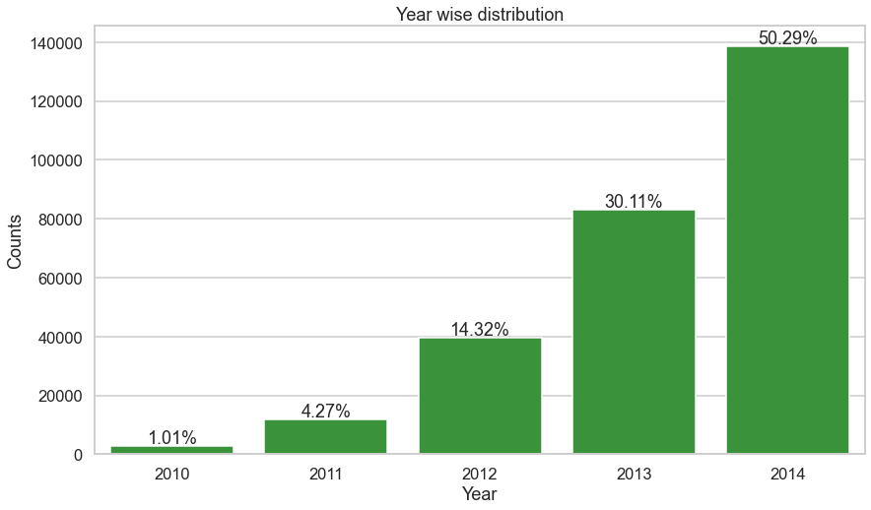
Year Wise Distribution
SECTION 02

Slide 10
SECTION 03
DATA PREPROCESSING
The Packages used for Data Preprocessing are numpy, pandas, sklearn, xgboost
Removing columns which adds minimal values eg- date_first_booking
Replacing missing values with -1
Split some columns to increase their relevance and meaning eg- date_account_created to year, month, day and timestamp_first_active to year, month, day
Filling -1 where age is less than 14 and greater than 100

Slide 11
SECTION 04
ONE HOT
ENCODING
One hot encoding is a process by which categorical variables are converted into a form that could be provided to ML algorithms to do a better job in prediction.
We use one hot encoder to perform “binarization” of the category and include it as a feature to train the model.
In Our project we have created binary labels for our target variable 'gender', 'signup_method', 'signup_flow', 'language', 'affiliate_channel', 'affiliate_provider', 'first_affiliate_tracked', 'signup_app', 'first_device_type', 'first_browser'and split them into several target variables i.e - each category has a label ‘1’ or ‘0’.

Slide 12
SECTION 05
MULTI
CLASSIFICATION
A classification task with more than two classes; e.g., classify a set of images of fruits which may be oranges, apples, or pears. Multi-class classification makes the assumption that each sample is assigned to one and only one label: a fruit can be either an apple or a pear but not both at the same time.
The challenge in Kaggle was to classify the destination for each particular user.

Slide 13
SECTION 05
MULTI
CLASSIFICATION
We have used the library Xgboost for this purpose
XGBoost is an algorithm that has recently been dominating applied machine learning and Kaggle competitions for structured or tabular data. XGBoost is an implementation of gradient boosted decision trees designed for speed and performance
We have used XGBoost because it is way more faster than the existing gradient boosting applications and supports various objective functions including classification and ranking

Slide 14
Conclusion
There are more number of females booking an Airbnb
The Average age people booking ranges from 30 - 40 years
The most used signup platform is a Web Browser (Safari , Chrome etc.)
There is gradual increase in bookings year wise

